Slide 1
DevOps Nedir ve Ne Değildir?
DevOps alanında bilinmesi gereken önemli konseptler

Slide 2



Özgür ÖZTÜRK
Cloud Solution Architect @MicrosoftDE
Geek in Chief @ayti.tech
@ozgurozturknet
https://ozgurozturk.net

Slide 3


Yazılım Geliştirme Döngüsü – Software Development Lifecycle
Dizayn
Kodlama - Oluşturma
Test
Uygulama
Gereksinim Analizi

Slide 4

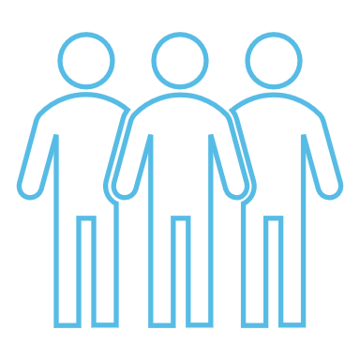
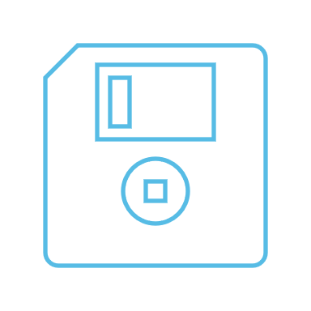

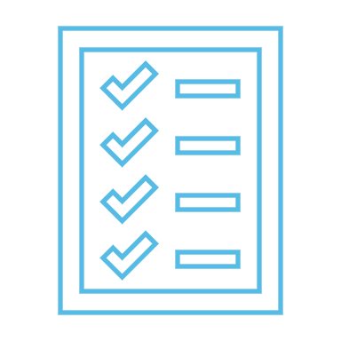
Son Sürüm
Beta
Nihai Sürüm
V1.0

Slide 5

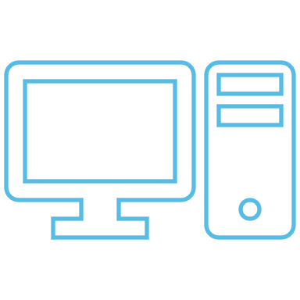





Yazılım Dağıtım Süreci
YAZILIM FİRMASI
MÜŞTERİ
SORUN
Back-End
Front-End
V1.0
Hotfix
Database

Slide 6
Yazılım Dağıtım Süreci
YAZILIM FİRMASI
Geri bildirim toplamak zor
Yazılımın kurulu olduğu sistemin kontrolüne sahip değil
Yüzlerce değişik sistem konfigurasyonu için uyumluluk yaratmak zor
MÜŞTERİ
Problem çözümü zahmetli ve yavaş
Yeni özelliklerin geldiği sürümlere erişmek aylar sürüyor
Altyapı oluşturma ve yönetme işlemleri zahmetli ve pahalı

Slide 7
Software as a Service Modeli
SORUN
YAZILIM FİRMASI
MÜŞTERİ
Back-End
Front-End
V1.0
V 2.0
Hotfix
Database

Slide 8
DevOps
DevOps Yazılım geliştirme yani (Dev) ve yazılım operasyonunu yani (Ops) süreçlerini birleştirmeyi amaçlayan bir yazılım mühendisliği kültürü ve uygulamasıdır. DevOps hareketinin temel özelliği, entegrasyon, test, dağıtım ve altyapı yönetiminden, yazılım yapımının her aşamasında otomasyon ve izlemeyi güçlü bir şekilde savunmaktır. DevOps, iş hedefleri ile yakın uyum içinde, daha kısa geliştirme döngüleri, artan dağıtım sıklığı ve daha güvenilir sürümler hedefler.

Slide 9

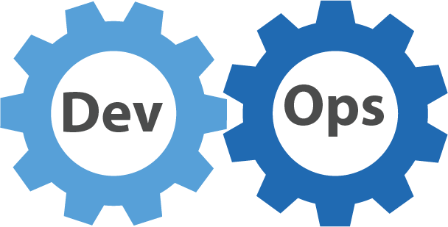
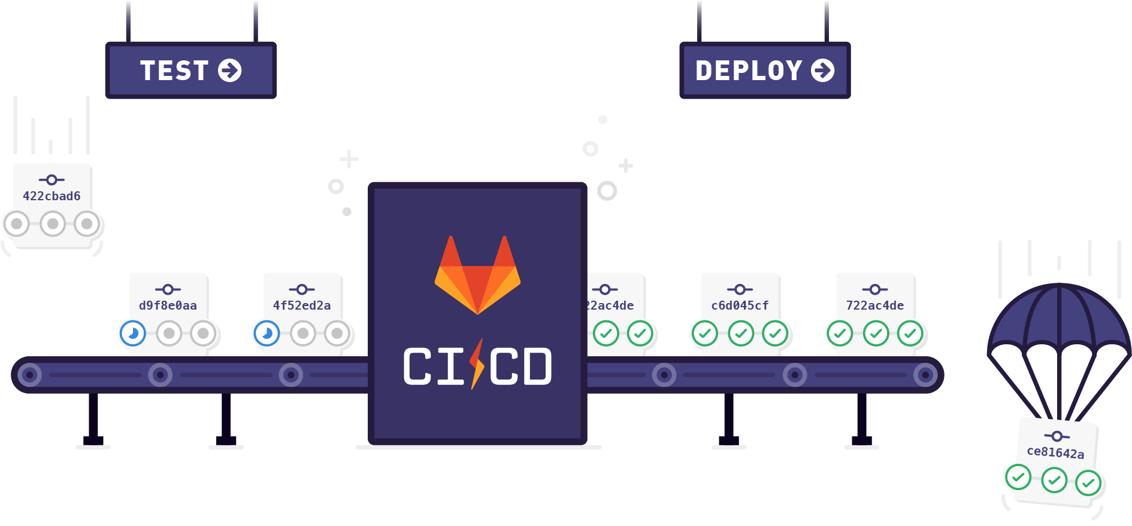





DevOps
PRODUCTION
Back-End
Test
Stage
Front-End
Database

Slide 10
Uygulamaları oluşturma şeklimiz değişti
Geçmiş
Oluşturma süreci uzun
Monolithic uygulamalar
Servers and VMs
Data az önemli
Desktop
Ayrı yazılım-operasyon-altyapı ekipleri
Günümüz
Sürekli geliştirme
Loosely-coupled apps, microservices ve containers
Serverless
Big Data
Mobile
Servis temelli DevOps ekipleri
On-Premises
Infrastructure Platform
IaaS
Infrastructure Platform
“lift & shift”
CaaS
Container Platform
PaaS
Application Platform
FaaS
Serverless Platform
Notes:
Legacy Apps
Monolithic - Built as a single unit with few separate services or components. Any services which are used tend to be custom built for the App.
Tightly Coupled - Tend to have internal and external dependences that impact both reliability and development agility.
Long Delivery Cycle - Slow to test, deploy, and scale. Making iteration difficult.
IT Dependent - Dependent on long lead time bare metal provided by IT. With complicated patching and update process.
Internet Apps
Service Oriented - Build modularly using packaged middleware, common services, and service oriented architectures (SOAs).
Loosely Coupled - Technology like messaging stacks and queues used to disintermediate apps. Management and diagnostic tools integrated into Apps.
Agile Delivery - Dependency management and disintermediation allows software to be built incrementally. Shortening delivery times from years to months.
Virtualized - Software hosted on virtualized infrastructure that reduces IT dependencies, improves delivery time, and simplifies update process.
Cloud Apps
Cloud Based Service - Applications built using application programming interfaces (APIs), software as a service (SaaS) Services, and independently scaling Microservices. With custom code only needed for core business logic.
Distributed - Applications use cloud services and APIs, further disintermediating tiers. Often making use of on demand services that are not instantiated when not in use.
DevOps - Continuous Integration, Continuous deployment, and Testing in Production used to shorten delivery and scale times from months to days or hours.
Platform Based - Applications written to platform as a service (PaaS) or infrastructure as a service (IaaS) based cloud platforms. Reducing scale times to minutes or even seconds and simplifying the patching and deployment process.
Acronyms
CaaS: containers as a service
FaaS: framework as a service
VM: virtual machine

Slide 11

Our industry does not respect tradition -- it only respects innovation. Satya Nadella CEO Microsoft

Slide 12
Katma değerin müşterilere hızlı bir şekilde ulaşması ve kullanılabilir durumda kalması gerekir
Accelerate
delivery
Optimize
reliability
Notes:
But, it’s not enough to have the worlds most efficient and collaborative developers
This code needs to be realized in functioning products that your customers can use
And these products and services need to be reliable, scalable and secure

Slide 13
Ya da Diğer Bir Deyişle:
“Uçağın motorunu havadayken değiştirmek”
Notes:
Traditional methods of delivering and operating software need re-thinking, especially in a cloud based world.
A business needs to move fast and innovate
But because of the manual nature of deployments and the siloed organizational structures, processes and tools – human error is inevitably introduced which leads to:
High failure rates when changes are implemented and
Long times to recover from outages
In a bid to improve reliability in these situations, we traditionally implement further controls – via more manual processes, and approval gates.
But, this doesn’t improve overall system reliability, and merely introduces:
Long lead times for changes and
Low deployment frequency

Slide 14
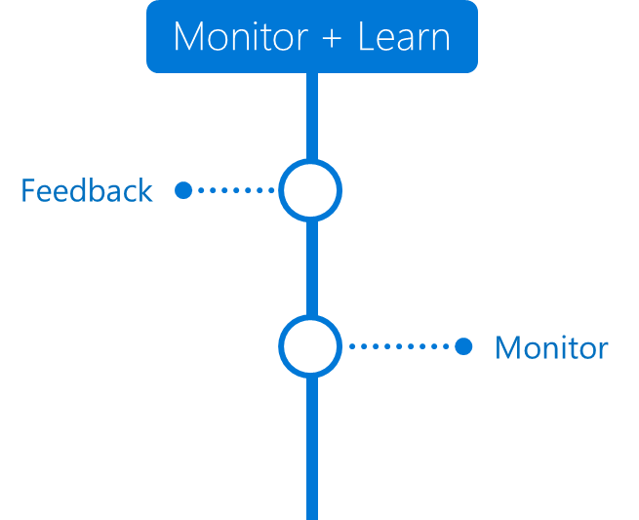

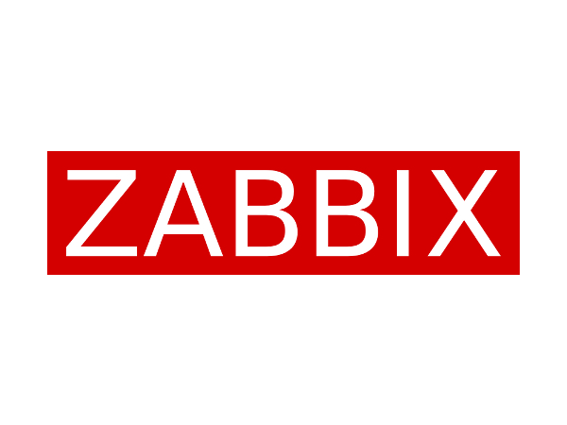

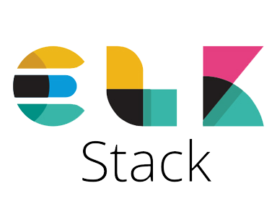
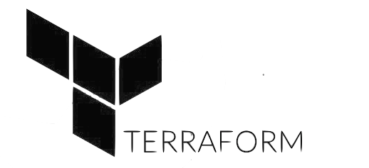



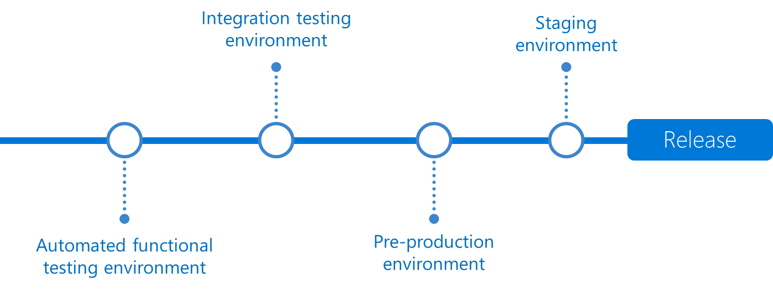
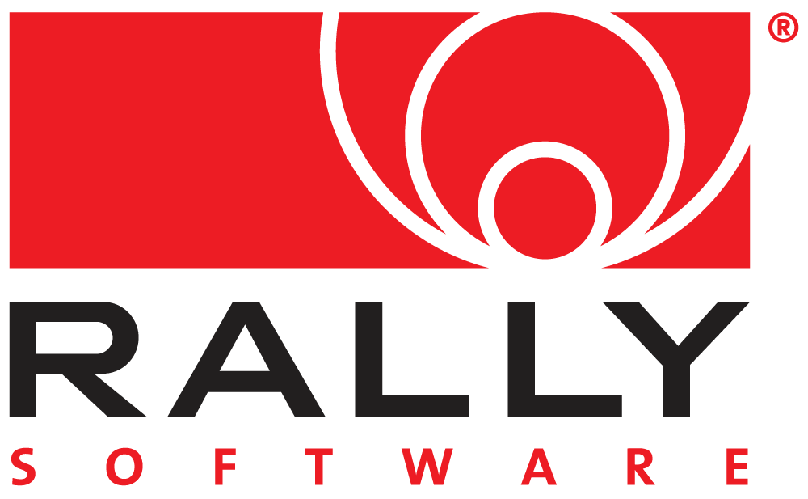
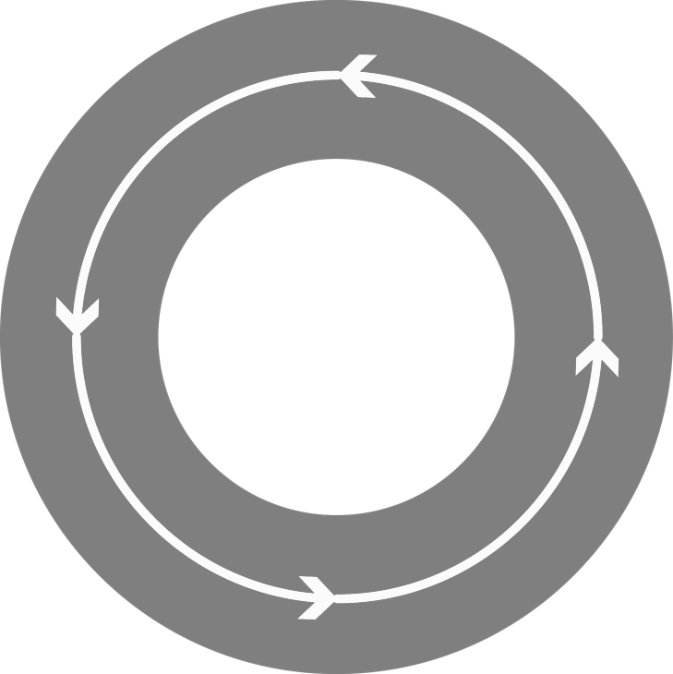

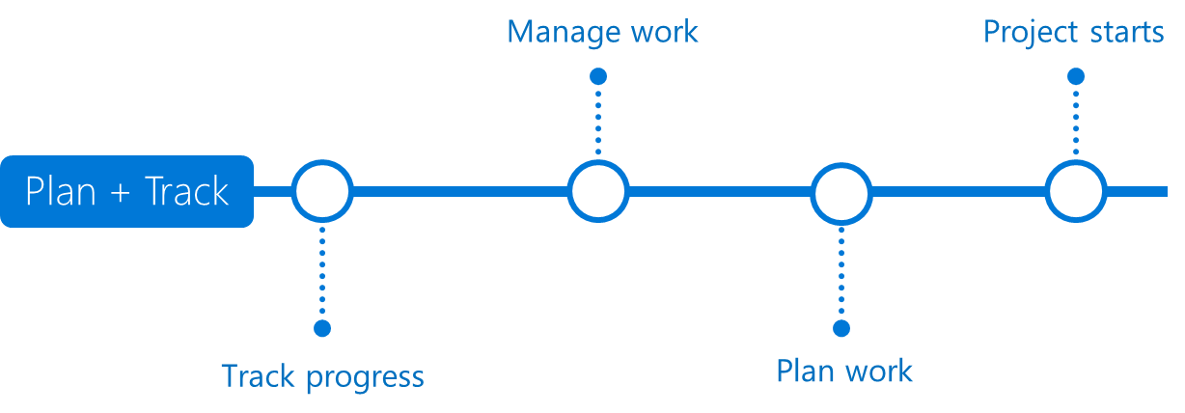


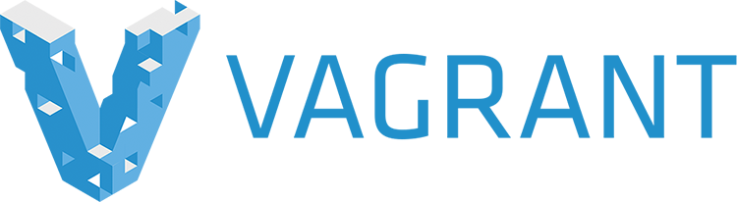




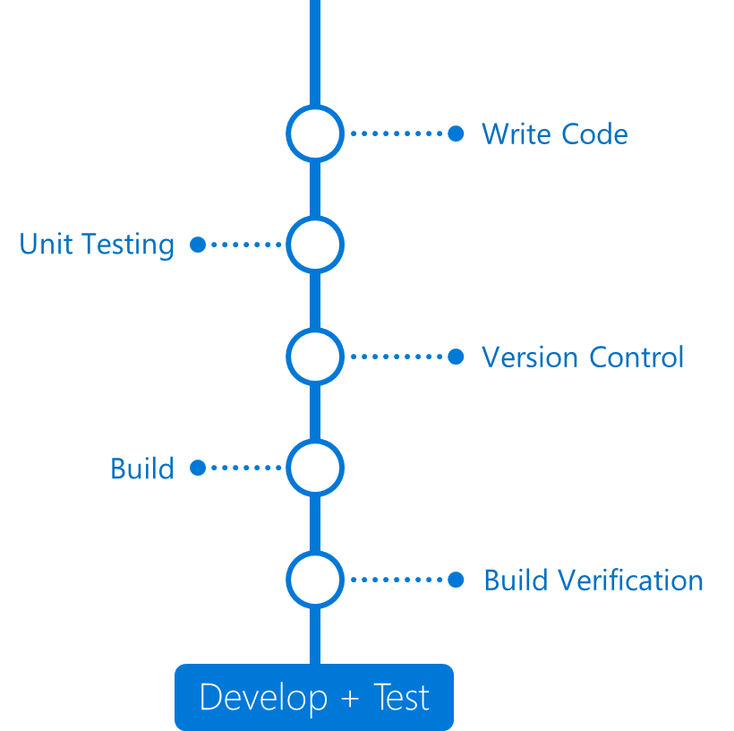




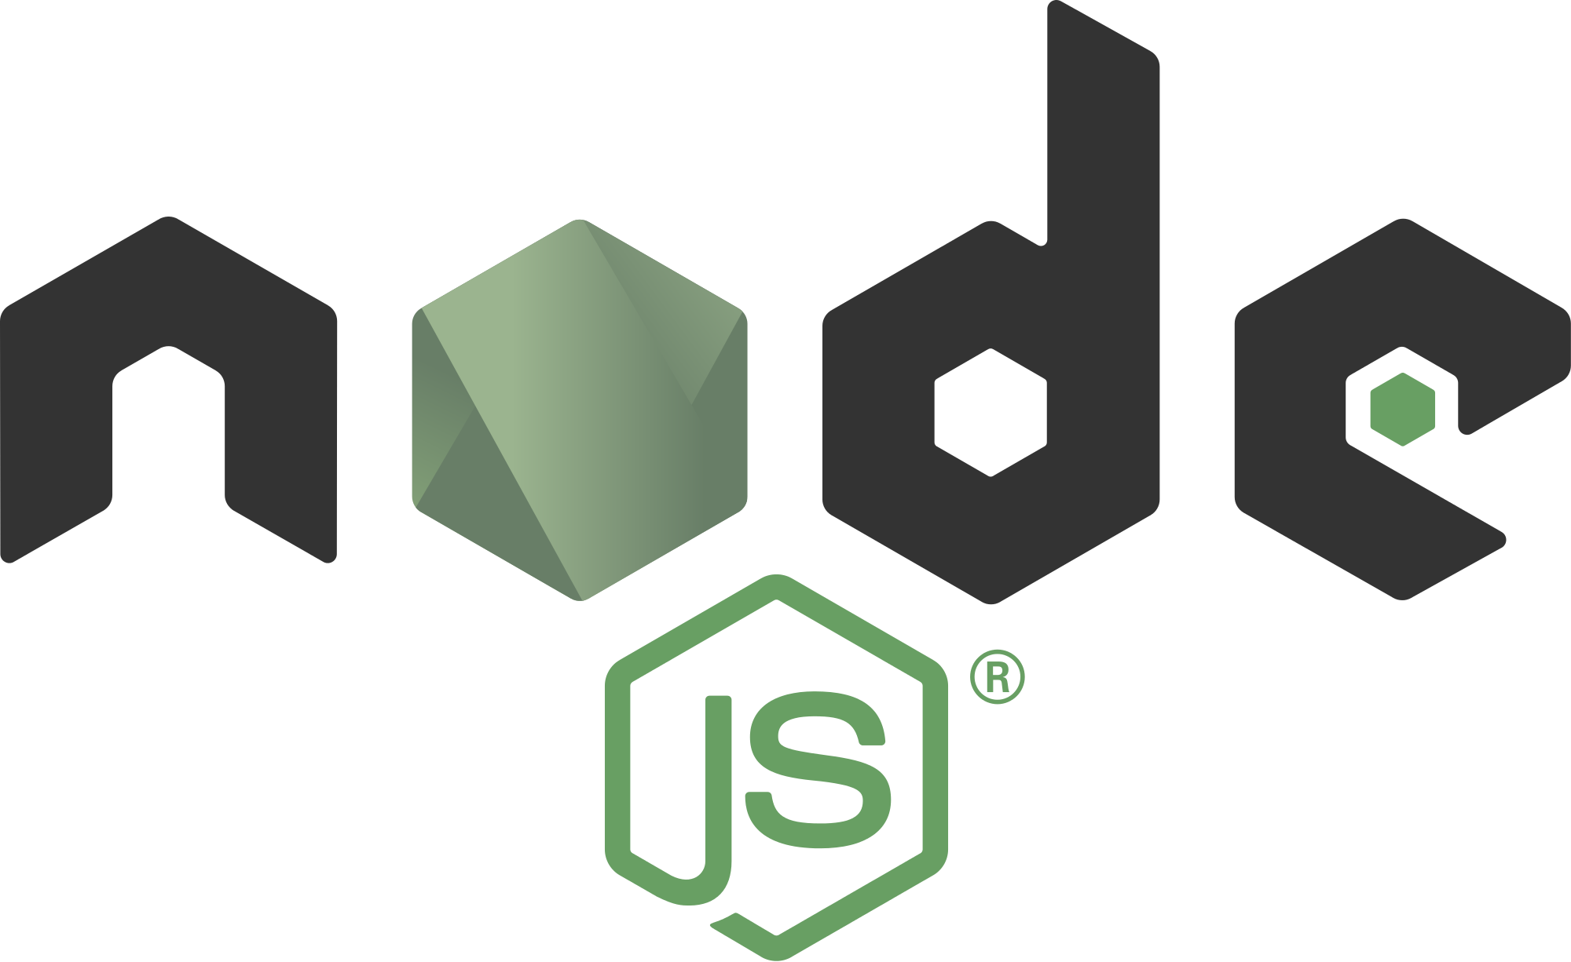
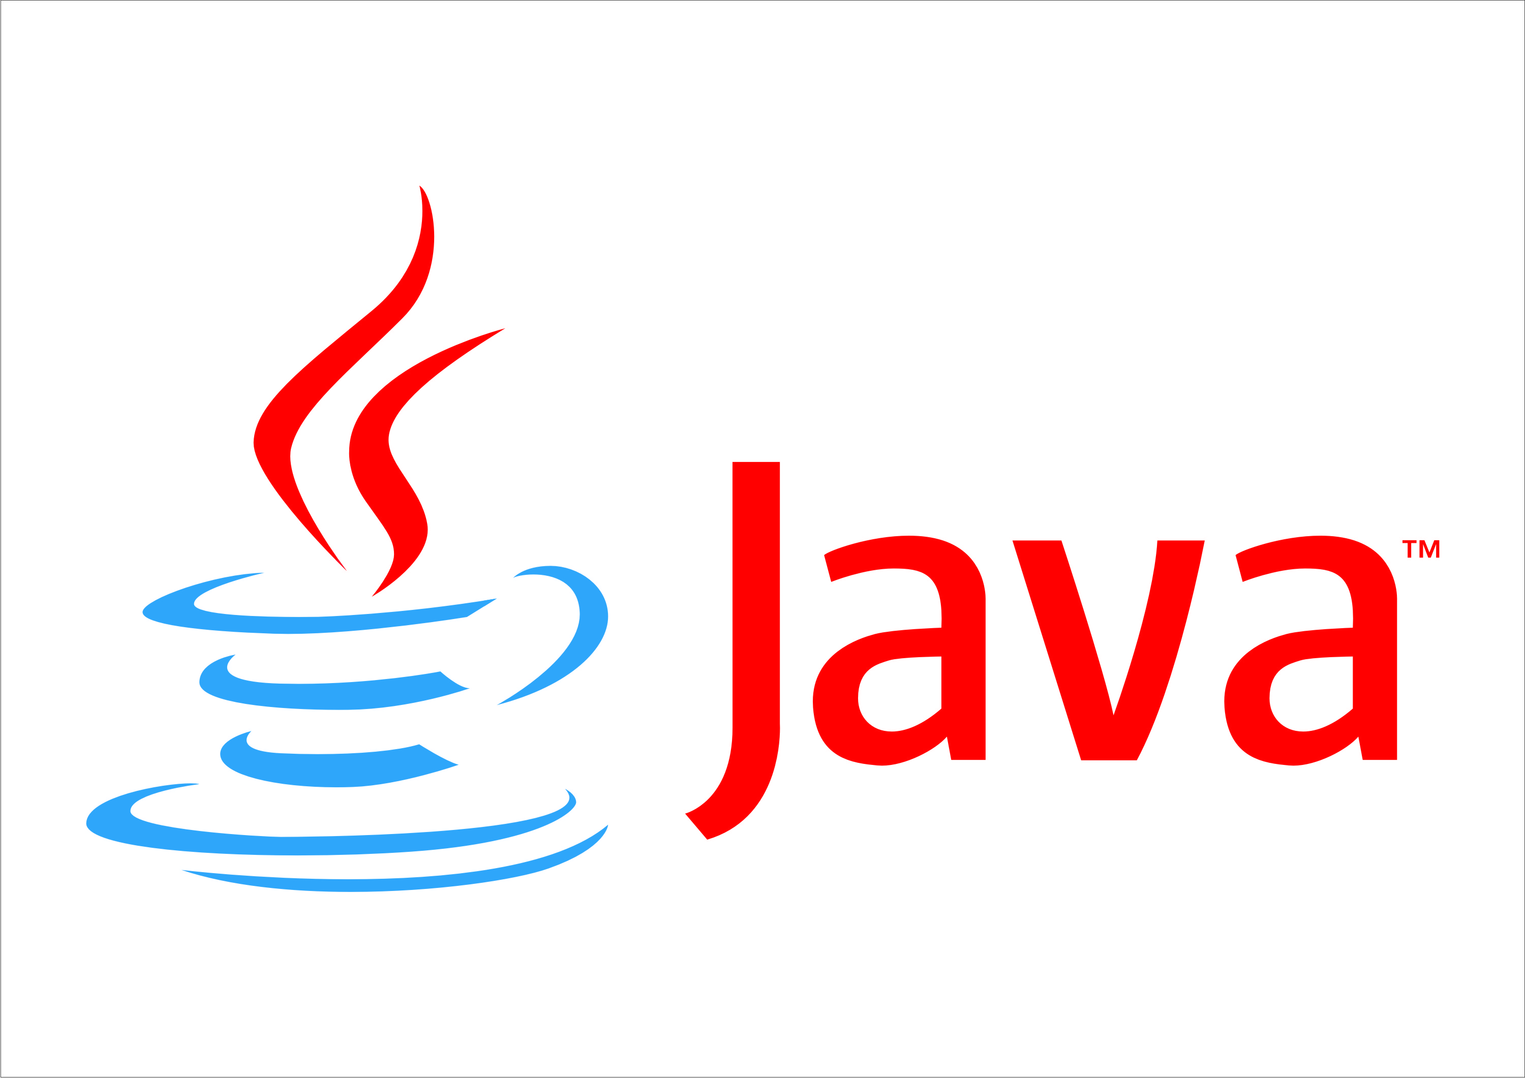

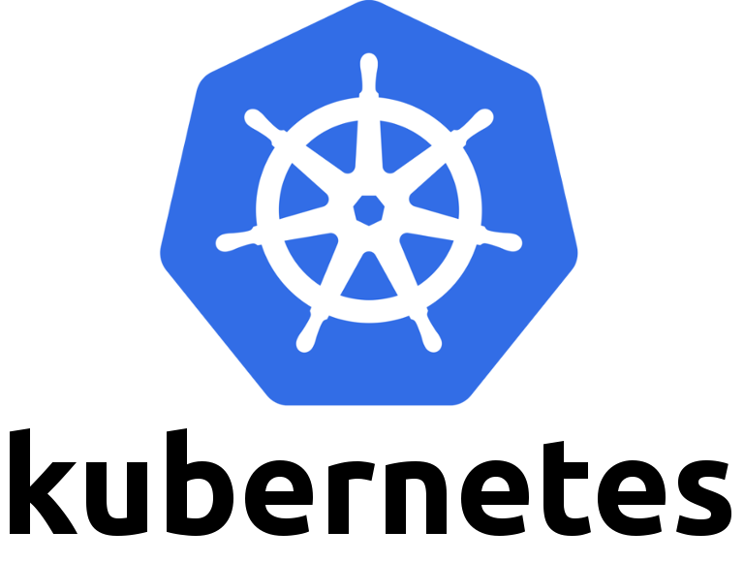






Ekosistem
DevOps
DevOps

